Slide 1

#CTEMonthMN | www.minnstate.edu/system/cte/index.html | February 2018
What is “College?”
Notes:
SCRIP SUGGESTION:
Introduce yourself and/or this presentation’s topic. Provide context of how this presentation fits with other information students have received about career exploration, career planning and/or Personal Learning Plans.
NOTES:
Public and nonprofit Presenters/Educators/Advisors have permission to customize/edit these slides to use with students.
Original PowerPoint created by:
Denise Felder, Minnesota State Colleges & Universities
April Schnell, Minnesota Department of Education
2018
Use this PowerPoint as part of your career and college readiness curriculum.

Slide 2




What Do You Plan to Do After High School?
Notes:
SCRIPT SUGGESTION:
Lead group discussion about student’s post-high school graduation plans. How did they choose those plans? What about their plans excites them, scares them? Who helped them make their plans?
What do students expect their lives will be like in 10 years? How do their immediate plans help them with their 10 year goals?
NOTES:
Goal of this presentation is to provide educators and advisers information/resources to encourage and equip their students to take charge of their own career and college planning.

Slide 3

69% of public high school graduates went to a postsecondary institution the following fall.
Most MN High School Grads Go to College
Source: MN Office of Higher Education
Notes:
SCRIPT SUGGESTIONs:
69% does not include those who go into the military to receive career training, or those who are in registered apprenticeships.
For students who say they “want to go to college,” and for students who say “they can’t get into college, can’t afford college, or college is not right for them” – Ask them to define “college.” What images come to mind, what do you do there? Where is college? Ask them for examples.
NOTES:
Postsecondary Education
A formal instructional program which curriculum is designed primarily for students who have earned a high school diploma or the equivalent. Includes two-year colleges and four-year colleges and universities as well as academic, vocational, and continuing professional education programs. Also called higher education.
https://careerwise.minnstate.edu/info/glossary.html

Slide 4

What is ‘College?’
Notes:
SCRIPT SUGGESTION:
For students who say they “want to go to college,” and for students who say “they can’t get into college, can’t afford college, or college is not right for them” – Ask them to define “college.” What images come to mind, what do you do there? Where is college? Ask them for examples.
NOTES:
Definition of College
A postsecondary educational institution that offers undergraduate programs, but usually no graduate degree programs. Undergraduate programs awards include certificates, associates' and bachelor's degrees.
Definition of University
A higher education school that offers both undergraduate and graduate degree programs. Source: CareerWise https://careerwise.minnstate.edu/info/glossary.html

Slide 5

“I want to go to college.”
Image: www.baskinrobbins.com
Notes:
SCRIPT SUGGESTIONS:
Saying “I want to go to college” is as specific as saying “I want ice cream.”
If you gave someone a scoop of butter pecan ice cream, they licked it and said they did not like it, would you assume that that person hated all types of ice cream? A student who goes to a four year private school and drops out after 3 years and changing their major multiple times might think that they are not college material. In reality, they might have picked the wrong college or wrong college program for them.
Someone who says “I can’t get into college or college is not for me” has not explored all their options.
NOTES:
In order to advise a student to the right college option for them, you need to know what each type of college offers, what degree types there are, the importance of transfer, and which postsecondary option fits the students’ career goals.

Slide 6
Type of Degree and/or Transfer Plans
Determine Your Starting Point
Types of Colleges
Community College
Technical College
Community and Technical College
University
Notes:
SCRIPT SUGGESTIONS:
Before enrolling in a college, decide if your first goal is to transfer to a university or earn a degree, also narrow down your choices of a major or program. Every college offers different programs and degree options.
Give statics on # of bachelor students who start at 2 year school and transfer to a university. https://www.insidehighered.com/news/2015/03/26/nearly-half-four-year-college-graduates-attended-two-year-college

Slide 7
Community College
2-year programs
Rainy River Community College
General Education courses
North Hennepin Community College
Normandale Community College
Associate Degrees (AS, AA)
Start Bachelor’s degree
Examples:
Notes:
SCRIPT SUGGESTIONS:
General Education courses like history, psychology, English, sociology.
Whether or not your college credits will transfer to another college or university depend on the accreditation of your most recent college and other factors. Check with the college or university that you want to transfer into to find out if they accept credits from the first school. For example, a student who went to Saint Paul College two years ago and now wants to enroll at Metro State should call Metro State to find out if they accept credits from Saint Paul College and for which courses.
NOTES:
The MN Office of high Education has good information about transfer, accreditation and validating the claims of schools: http://www.ohe.state.mn.us/mPg.cfm?pageID=907.

Slide 8
Technical Colleges
1-2 year programs
Specific knowledge and skills leading to specific career
Examples:
Dakota County Technical College
Anoka Technical College
Construction Electrician
IT Management
Diplomas, Certificates and Associate Degrees (AAS)
Northwest Technical College
Notes:
SCRIPT SUGGESTIONS:
An Associate’s program at a technical college includes the liberal arts or general education courses take at other colleges. Diploma and certification programs might not include the general education courses.

Slide 9
Combined Community & Technical Colleges
Both technical and community college courses and programs
Start Bachelor’s degree
-or-
Learn skills for specific career
Examples:
Fond du Lac Tribal & Community College
Century College
Minnesota West Community & Technical College
Notes:
The MN Office of high Education has good information about transfer, accreditation and validating the claims of schools: http://www.ohe.state.mn.us/mPg.cfm?pageID=907.

Slide 10
University
Graduate and undergraduate programs
Courses and programs leading to:
Bachelor’s degree
Master’s degree
Other advanced degrees
Examples:
Metropolitan State University
Minnesota State University, Mankato
St. Cloud State University

Slide 11
Postsecondary Credentials
2- or 4-year Degree
Certificate
Licensure
Apprenticeship
Military Programs
College Diploma
Notes:
SCRIPT SUGGESTIONS:
The type of college or university you go to depends on the type of degree or credential you want, and your plans to transfer.
Discuss how economic and job market changes require postsecondary education to qualify for high-paying jobs. Did student’s parents graduate from college in order to get a good job? Did their grandparents? What is the connection between postsecondary education and high-wage employment in other countries?
Any type of formal training or education program after high school is needed to qualify for middle and high skill careers. Jobs that used to ask for only a high school diploma now require an associate’s degree, a college certificate or an industry recognized credential like becoming an apprenticeship journeyman.
NOTES:
Definition of Higher Education
Postsecondary education at colleges, universities, junior or community colleges, professional schools, technical institutes, and teacher-training schools.
Definition of Postsecondary Education
A formal instructional program which curriculum is designed primarily for students who have earned a high school diploma or the equivalent. Includes two-year colleges and four-year colleges and universities as well as academic, vocational, and continuing professional education programs. Also called higher education. Source: CareerWise https://careerwise.minnstate.edu/info/glossary.html
Apprenticeship information: https://careerwise.minnstate.edu/education/apprenticeships.html
Military options: https://careerwise.minnstate.edu/careers/military.html

Slide 12
Types of Degrees
Associate of Applied Science (AAS)
Associate of Arts (AA)
Associate of Science (AS)
2-year program
Technical College
May enter career after grad
General and technical courses
Ex: 3D Animation, Welding
2-year program
Combined & Community Colleges
Transfer to Bachelor’s
General and liberal arts courses
Ex: Psychology
2-year program
Community College
Transfer to Bachelor’s General and sciences courses
Ex: Engineering, Biology
Source: www.collegeatlas.org
Notes:
SCRIPT SUGGESTIONS:
AAS program can also include preparing for or earning licensure in a specific career.
There is also a Associate in Fine Arts is a specialized associate degree in music or in art. Associate degrees require the equivalent of at least two years of full-time study.

Slide 13
Types of Degrees
Bachelor of Science (B.S.)
Bachelor of Arts (B.A.)
Post-Baccalaureate Certificate
4-year program
College or University
Pre-requisite for graduate degree
Career-specific and technical majors
Ex: Nursing, IT, Media Studies
4-year program
College or University
Pre-requisite for graduate degree
Liberal arts majors
Ex: English, Sociology, History
Less than 1 year
University
Must have Bachelor’s
Specific academic or career courses
Ex: Design for
E-Learning
Sources: www.collegeatlas.org; http://college.usatoday.com
Notes:
SCRIPT SUGGESTIONS:
It’s good to have a career field in mind when you choose your major so that you will know if you are pursuing the right type of degree and the right major for that career.
The importance of your major (vs earning any bachelor’s degree) varies depending on the field you are entering. For example, its important for someone in Computer Science or in Finance to have a degree related to their field. Some Human Services positions and some Business positions look at job candidate’s work experience as well as their major.
Post-Baccalaureate Certificates are a new type of program for people who want to go to grad school but need a shorter program. Someone with a graduate degree can also enter a Certificate program to gain knowledge in a specific area. These programs usually go in-depth into a specific career area. Examples: Adult/Gerontology Primary Care Nurse Practitioner for someone with a Bachelor’s in Nursing, Design of User Experience for someone with a Bachelor’s in Web Design; Urban Secondary Education for someone with a Teaching degree.
NOTES:
Bachelor’s Degree also know as Baccalaureate Degree. Associates Degree and Bachelor’s degree are Undergraduate degrees. Masters, Ph.Ds and Professional Degrees are Graduate degrees.

Slide 14
Types of Degrees
Master’s Degree
(M.A. or M.S)
Doctorate Degree (Ph.D.)
Professional Degree
(J.D., M.D., D.D.S)
2-year graduate program
University
Research project/Thesis paper to graduate
MA is social sciences
MS in sciences or technical fields
2-4 year graduate program
University
Dissertation to graduate
Earn title of Doctor
1-3 year graduate program
University
Required degree for medical doctor, dentist, veterinarian, lawyer
Source: www.collegeatlas.org
Notes:
SCRIPT SUGGESTION:
You need a Bachelor’s degree to enter a graduate program, but grad programs are not hieratical. For example, a Masters is not prerequisite for a Ph.D.
You can also earn multiple degrees of any type. For example, some people have two Bachelor’s degrees in different fields and/or more than one Ph.D.
A Professional Degree is required to practice medicine or law. It is illegal to work as a doctor, dentist, veterinarian, or lawyer without the appropriate professional degree and passing the appropriate requirements to be licensed in that professional.
Graduate degree programs usually have 2-years worth of courses but most people take several years to graduate. Many graduate students are in school part time and working full time, some stop going to school and return years later. Plus the research projects, thesis or dissertation projects, and practicums required can take several months to a few years to complete. It is common for someone to take 3-5 years to complete a master’s program, or10 years to complete a Ph.D.
NOTE:
Doctorate also known as Doctoral degree.

Slide 15
Stackable Credentials
Diplomas & Certificates (1-2 years)
Associate’s Degree (2 years)
Bachelor’s Degree (4 years +)
Master’s Degree (2 years+)
Doctorate Degree (2 years +)
Professional Degree (2 years +)
Post-Baccalaureate Certificate (varies)
Work While in School
Work
Work While in School
Series of ascending degrees and formal training that allow someone to work in a chosen field as they progress to higher skilled occupations.
Notes:
SCRIPT SUGGESTIONS:
Talk with students about # of students who transfer, # of students who start at 2 year college and complete 4 year degree. Transfer is normal. Taking more than two or four years to complete college is normal.
Any student can work while they are in any program type. It’s common for college students to work while in school either in their chosen field or change careers after earning a degree. It’s also common for people to earn a degree, work for several years then come back to school to earn a higher degree to prepare for a promotion, to change careers or for personal fulfillment.
NOTES:
Associate’s Degree (A.A., A.A.S) 2 years
Bachelor’s Degree (B.A. or B.S) 4 years +
Post-Baccalaureate Certificate Length varies, usually less than 1 year
Master’s Degree (M.A. or M.S) 2 years+
Doctorate Degree (Ph.D.) 2 years +
Professional Degree (J.D., M.D., D.D.S) 2 years +

Slide 16
Transfer
25% of community college student transfer to a 4-year college within 5 years
37.2% of U.S. college students transfer at least once within 6 years
41% of all new students at Minnesota State universities are transfer students
Half of new Minnesota State university students transfer from community and technical colleges
62% of students who transferred from community college to 4-year college earn a bachelor’s degree
Sources: www.insidehighered.com/quicktakes/2015/07/08/more-third-college-students-transfer; https://ccrc.tc.columbia.edu/media/k2/attachments/what-we-know-about-transfer.pdf

Slide 17
Minnesota State Colleges & Universities
54 Campuses in 47 Minnesota communities
3,700 academic programs
(online and on campus )
396,000 students each year
30 Colleges
7 Universities
http://minnstate.edu/colleges/campuses.html
Notes:
SCRIPT SUGGESTIONS
Minnesota State schools are more affordable than other colleges and have high-quality academic programs. Minnesota State schools have a variety of financial od options. Compare costs among Minnesota State and tuition costs of other colleges in Minnesota here: http://minnstate.edu/admissions/collegecostcomparison.html.
NOTES:
Minnesota State campus admissions information: http://minnstate.edu/admissions/index.html

Slide 18
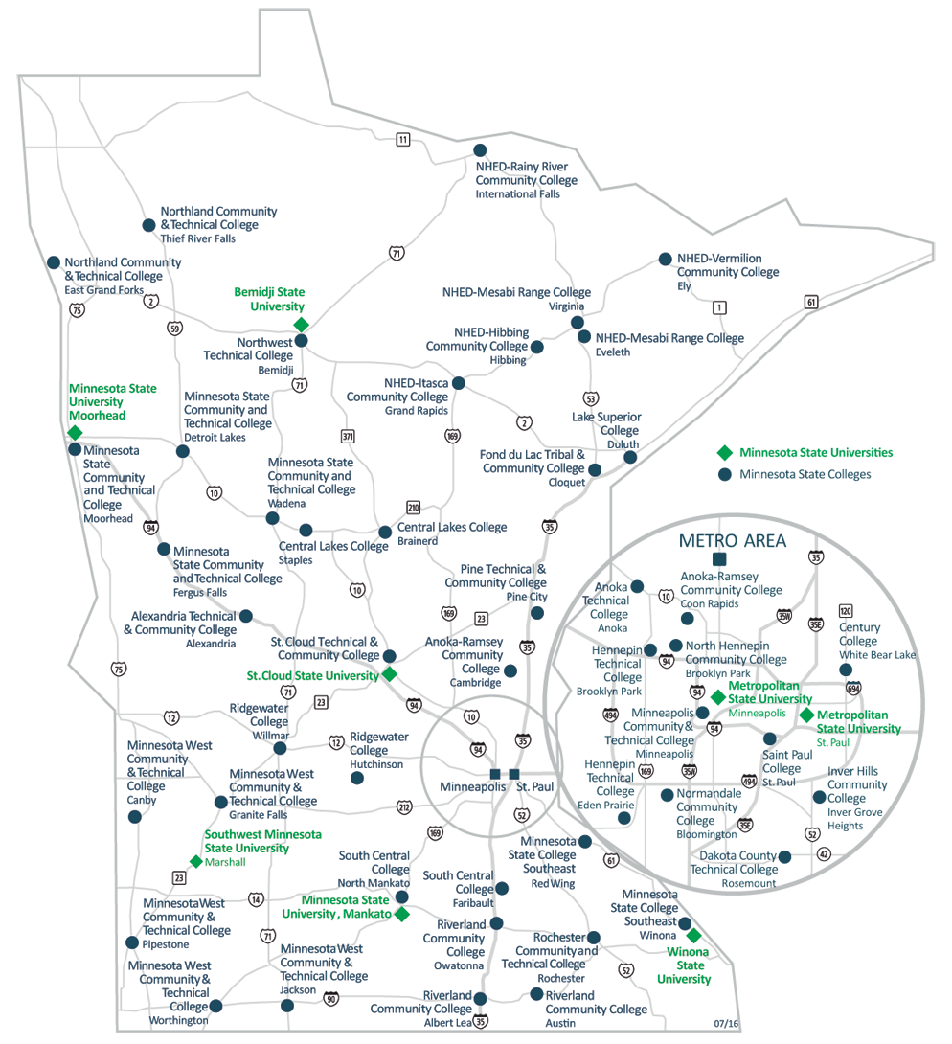
Minnesota State Colleges & Universities
http://minnstate.edu/colleges/campuses.html
Notes:
SCRIPT SUGGESTIONS
Remember – college is like ice cream with lots of different flavors. Think about whether you want to go to a two year school or 4-year university – remember you can transfer if the school is not the right fit for you. Also think about whether you want to go to college close to home or several hours away. Do you want to live on campus in a dorm, in an apartment near school, or live at home? Are campus activities important to you like participating in intermural sports, joining clubs, participating in theater, and other social events?
Once you have narrowed your choices of colleges to 3-5 campuses, visit each college in person or take a virtual tour. Visiting in person is best so you can literally feel if you fit in on the campus and ask questions of current students and of the faculty and staff. Visit the website for each of your top schools to get more information about visiting.
NOTES
Colleges outside of Minnesota can be explored on CareerOneStop (https://www.careeronestop.org/Toolkit/Training/find-local-training.aspx) or College Boards’ Big Future (https://bigfuture.collegeboard.org/find-colleges).

Slide 19

Discussion
What are the two most important things for you in choosing a college?
What is confusing about choosing a college?
Notes:
NOTES
Add in discussion questions for the group.
And/or lead the group in a college exploration activity – look up details on colleges to choose their personal top 5 school options. Help students to plan next steps in college exploration or application process.

Slide 20

Denise Felder, Director of CTE Professional Development
April Schnell,
Career Development Specialist
Notes:
NOTES:
Public and nonprofit Presenters/Educators/Advisors have permission to customize/edit these slides to use with students. Add a slide with your own contact information.
Original PowerPoint created by:
Denise Felder, Minnesota State Colleges & Universities
April Schnell, Minnesota Department of Education
2018

